Slide 1
Module 6. More on File Management

Slide 2
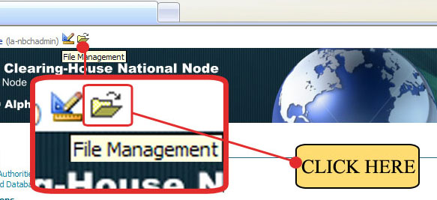
6.1 How to costumize the banner
Update banner.jpg file from File Management. The banner must be 940px wide.
Step 1. Click on the File Management Icon, as shown.

Slide 3
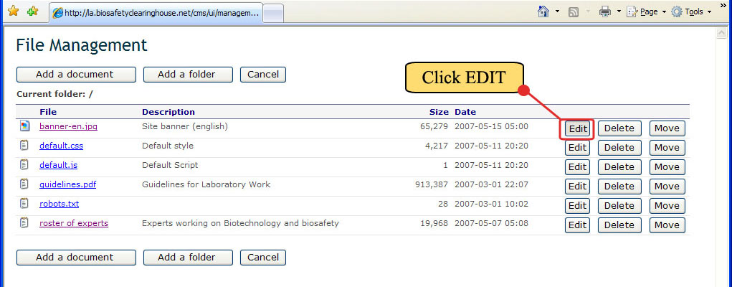
6.1 How to costumize the banner
Step 2. The File Management now appears. Click Edit button to the right of the File named banner.jpg.

Slide 4
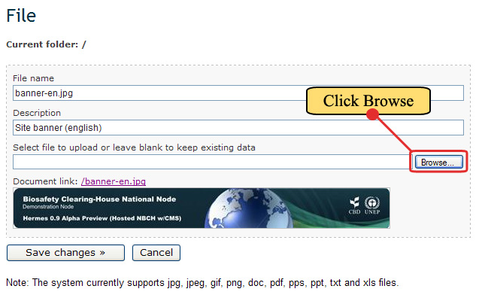
6.1 How to costumize the banner
Step 3. The File page associated with the banner.jpg file will appear. To replace the existing banner, click Browse button to select the banner file to be uploaded.

Slide 5
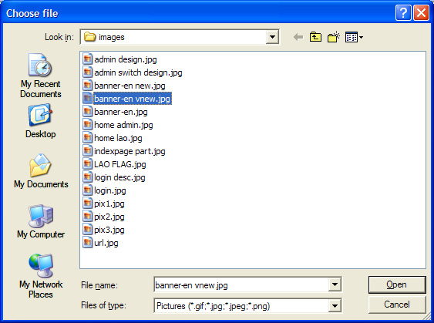
6.1 How to costumize the banner
Step 4. The choose file window will appear. Here select the photo file of the new banner. Then click Open after choosing the file.
NEW BANNER FILE
CLICK HERE

Slide 6
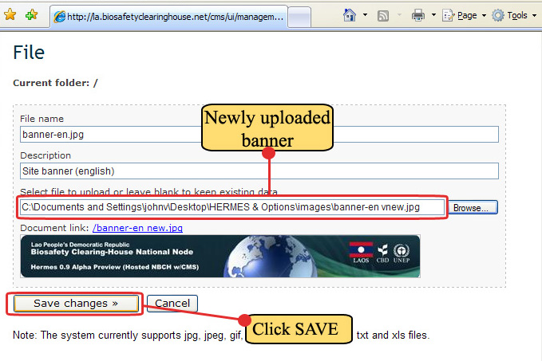
6.1 How to costumize the banner
Step 5. Now, the file page will show the selected file appearing on the Select file to upload box…. (beside the Browse button) as shown. Then click Save Changes.

Slide 7
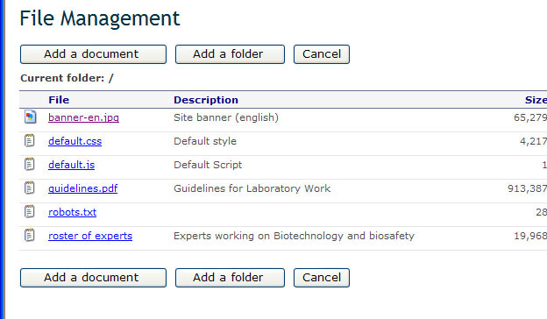
6.1 How to costumize the banner
Step 6. Now the File Management will reappear on screen. Click Cancel button to exit this page. The cancel button will be renamed "Quit file management" in the next release of Hermes.
CLICK HERE

Slide 8
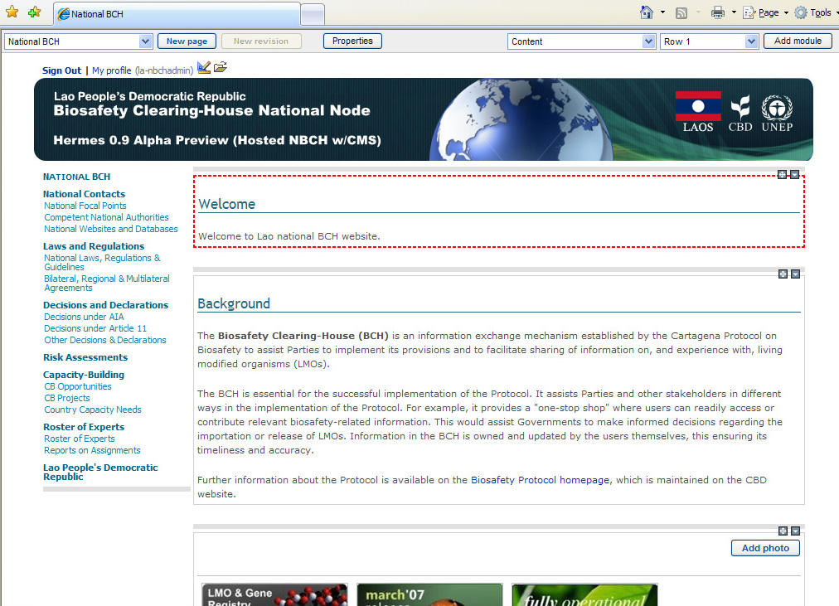
6.1 How to costumize the banner
The index page of NBCH will now appear with a new banner as shown.
NEW BANNER

Slide 9
6.2 The NBCH default stylesheet
The default.css is a stylesheet that contains the default set of rules that describe the appearance of all the pages within the NBCH website.
Within this stylesheet, rules are set for the following: layout of headings, paragraphs, navigation menus and other elements in the page.

Slide 10
6.2 The NBCH default stylesheet
These set of rules include the following:
  FONT family,
  FONT color,
  FONT size,
  FONT weight,
  Text alignment,
  Text decoration, etc.

Slide 11
6.2 The NBCH default stylesheet
1 | /******************************************
2 | Main Tags
3 | ******************************************/
4
5 | body
6 | {
7 | font-size:11px;
8 | font-family:Verdana, Arial;
9 | margin:0px;
10 | }
11
12 | a
13 | {
14 | color:#00309c;
15 | text-decoration:none;
16 | }
17
18 | a:visited {}
19 | a:active {}
20 | a:hover
21 | {
22 | color:darkolivegreen;
23 | text-decoration:underline
24 | }
25
26 | /* Default content text */
27 | .hlite
28 | {
29 | font-weight:normal;
30 | font-size:11px;
31 | color:#505050;
32 | line-height:13pt;
Shown are the first few lines (lines 1 to 44) of default.css that is used by the NBCH website.

Slide 12
6.2 The NBCH default stylesheet
33 | font-family:Verdana, Arial
34 | }
35
36 | /* Default content text bold */
37 | .hliteb
38 | {
39 | font-weight:bold;
40 | font-size:11px;
41 | color:#404040;
42 | line-height:13pt;
43 | font-family:Verdana, Arial;
44 | }
45 | etc….

Slide 13
6.2 The NBCH default stylesheet
To change the font type, color and size of the content text, edit the lines 26 to 34.
 | OLD | NEW
26 | /* Default content text */ | /* Default content text */ | Retain
27 | .hlite | .hlite | Retain
28 | { | { | Retain
29 | font-weight:normal; | font-weight:normal; | Retain
30 | font-size:11px; | font-size:12px; | Font size from 11px to 12px
31 | color:#505050; | color:# 0718f5; | Color from black to blue
32 | line-height:13pt; | line-height:13pt; | Retain
33 | font-family:Verdana, Arial | font-family:” Lucida Console” | Font type from Verdana, Arial to Lucida Console
34 | } | } | Retain

Slide 14
6.2 The NBCH default stylesheet
 | OLD | NEW
12 | a | a
13 | { | {
 |  | font-family:” Lucida Console” | Adding new line for font type Lucida Console
14 | color:#00309c; | color:# c20909; | Color from blue to red
15 | text-decoration:none; | text-decoration:none; | Retain
16 | } | } | Retain
17
18 | a:visited {} | a:visited {} | Retain
19 | a:active {} | a:active {} | Retain
20 | a:hover | a:hover | Retain
21 | { | } | Retain
22 | color:darkolivegreen; | Color:#f2ef17; | Color from darkolivegreen to yellow
23 | text-decoration:underline | text-decoration:underline | Retain
24 | } | }
In addition, anchor (also known as hyperlinks) effects can be modified by editing lines 12 to 24.

Slide 15
6.2 The NBCH default stylesheet
Given are sample settings for the stylesheet.
You can modify parts of the stylesheet on your desired settings.
To learn more about stylesheets, visit the site: http://www.w3schools.com/css/css_reference.asp

